Slide 1
APIs and AJAX
Damian O’Brien
9/27/2016

Slide 2
Recap
HTML
Interpreted by the browser to display web pages
Imports/Embeds CSS
Imports/Embeds Javascript
CSS
Style and display of the web page
Javascript
Allows you to turn a webpage from a static document into a slick, interactive application

Slide 3
Key Concepts
Request remote data via API calls
AJAX requests
JSON and JSON-P
Content refreshing methods

Slide 4
Question
Q. What is the most powerful function of the internet?
A. Exchange of information

Slide 5
Where is the data?
Most common sources of data are:
Static data in your HTML
Dynamic data that you have stored locally
Content from local DB
File contents
Notes:
Brochure sites, blogs, company websites

Slide 6
I WANT MORE DATA
Map data
Blog posts
Financial Data
Images
News Articles

Slide 7
Client-Side Scripting vs. Server-Side Scripting
Server-side scripting involves a scripting language:
PERL, PHP, Python, ASP, JSP, Ruby, …
The script executes on the server and sends HTML to the browser
Client-side scripting runs natively in the browser and almost exclusively refers to JavaScript **

Slide 8
Lesson Application
Simple Stock Ticker
*Write a simple webpage that loads the value of one or more stocks

Slide 9
How do I load remote data? [REQUEST]
As always, there are multiple ways to access remote data, but 2 of the most common include:
cURL
Server-side
Can run from anywhere, universally available
Simple but a little more involved (oldie but goodie)
Can’t run from JavaScript (or the web client), requires server-scripting
AJAX
Client-side
Asynchronous JavaScript and XML
Very simple, and easily integrated into the client UI
Send a Request!

Slide 10
Application Programming Interface
Or “API”
Processes requests and return responses
APIs expose datas and functions to external applications
Some are wide open
Some require licenses
Some are free
Some are paid
Most major sites/services have some sort of API
Call an API to return a formatted RESPONSE

Slide 11
Now what do I do with it?
Data retrieved from remote sites can come in a number of formats, including:
Flat text
Formatted text, i.e. CSV
XML
JSON
JSON-P
YAY!!!!!

Slide 12
Lesson Application
*Pull stock data from Yahoo Finances
Determine the method
License required (yes or no)
Look at the response formats

Slide 13
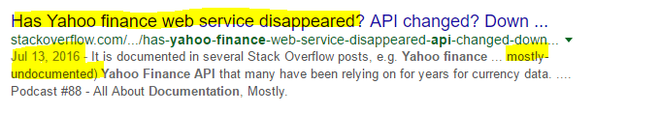
Lesson Application
OK, so where do we start?
Let’s pick the Yahoo Finance API
Search for “Yahoo Finance API documentation”
OK, Change of plans….let’s get our financial data from google

Slide 14
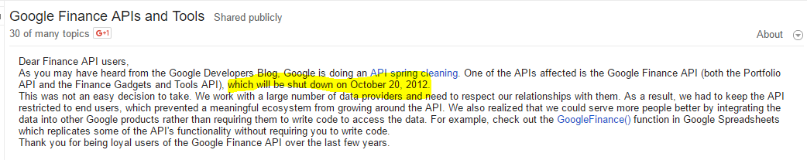
Lesson Application
Search for “Google Finance API documentation”
OK, trying again brings us to www.markitondemand.com
And checking their docs, we find the doc here: http://dev.markitondemand.com/MODApis/#doc_quote
No license, no payments, JSON(p) support, this will work!

Slide 15
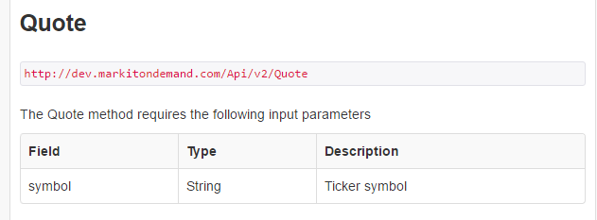
Lesson Application
We read:
So we need to send a request to http://dev.markitondemand.com/Api/v2/Quote with a “symbol” field and the ticker symbol

Slide 16
Passing parameters with a URL
http(s)://subdomain.domain.tld/path/site?key1=val1&key2=val2...
Http or Https is unencrypted vs encrypted
Sudomain is usually “WWW” but may vary
Domain is the site name
TLD can be: “com” “org” “net” “co” “to” “tv”....
Finally parameters are passed at the end of the URL following a “?” in key/value pairs:
key1=val1
key2=val2

Slide 17
Lesson Application
So based on the docs, we should have to use:
http://dev.markitondemand.com/Api/v2/Quote?symbol=goog
Great! (sort of), but we really want a JSON formatted response to simplify things. Reading the docs again shows we can put “/json” before the “?”
http://dev.markitondemand.com/MODApis/Api/v2/Quote/json?symbol=goog
OR JSON-P (this will be critical) with a “callback” parameter
http://dev.markitondemand.com/MODApis/Api/v2/Quote/jsonp?symbol=goog&jsoncallback=callback

Slide 18
JSON vs JSON-P - What’s the difference
We know we want our data in the JSON format
JSON-P is JSON “with Padding”
Allows you to data from a different server (different domain)
If you grab JSON from someone else’s site (a different domain), it WILL LIKELY NOT WORK
Both return the format we want, but the JSON-P is “padded” with a function definition

Slide 19
Lesson Application
First, let’s make sure we can access the remote data
See example 1 (example-01.php)
The Good
It works
The bad
Relies on server side scripting
One time data load
Requires manual page reloads
Notes:
Not bad, but we want to have it update

Slide 20
Lesson Application
Let’s reload the data on an interval
See example 2 (example-02.php)
The Good
It works
The data will reload itself
Uses the <meta http-equiv="refresh" content="10"> html tag in the head tag
The bad
Relies on server side scripting
Wipes away the page state each time
Notes:
Not bad, but we want to have it update

Slide 21
Lesson Application
Let’s do it all on the client side
See example 3 (example-03.html) <- NOTE: this is an html file
The Good
It seems easier
The bad
This doesn’t work at all, but it looks like it should
The request was blocked on the server side
Notes:
Not bad, but we want to have it update

Slide 22
Lesson Application
Let’s do it all on the client side
See example 4 (example-04.html) <- NOTE: this is an html file
Use JSON-P instead of JSON
The Good
We are loading the remote data entirely using HTML and JS
The bad
We still want to reload the data without refreshing the page
Notes:
Not bad, but we want to have it update

Slide 23
Lesson Application
Let’s do it all on the client side
See example 5 (example-05.html) <- NOTE: this is an html file
We will use JQUERY to get a little fancier
The Good
We are loading remote data AND refreshing it without reloading the page
The bad
We use an external helper library to give us a little more functionality, so the learning curve is a little steeper
This is an acceptable solution
Notes:
Not bad, but we want to have it update

Slide 24
Key Concepts Covered
APIs
Loading remote data
Using cURL to get remote data using server side scripting
Using AJAX to load remote data
JSON vs JSON-P
Data refreshing methods

